Slide 1

Phishing Attacks
Hacked
How to be prepared?
Presented by: Vaishnav M

Slide 2
01
Phishing
CONTENTS
02
Identifying fake websites
03
Social Engineering
04
Avoidance and mitigation

Slide 3
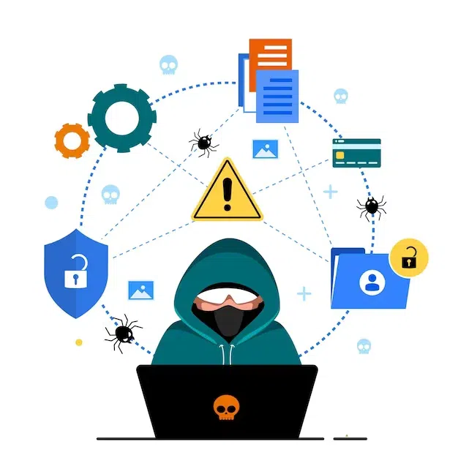
01
Phishing
Phishing is a cyberattack in which attackers impersonate trusted entities to trick individuals into revealing sensitive information — such as passwords, financial data, or personal details — or to install malicious software. It relies on deception and human error rather than technical flaws, making it one of the most common and effective forms of social engineering.

Slide 4
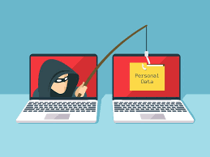
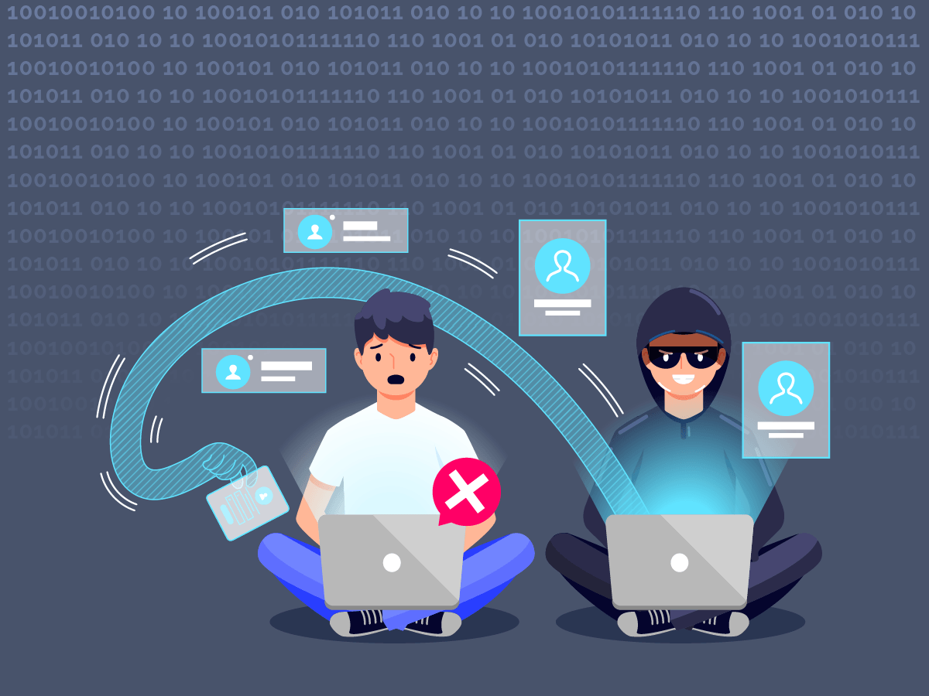
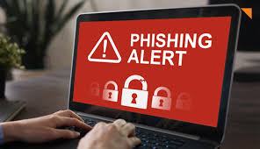
PHISHING ATTACKS
Phishing attacks are a form of social engineering where attackers deceive individuals into revealing confidential information such as usernames, passwords, credit card numbers, or installing malware. These attacks exploit human psychology rather than technical vulnerabilities, making them one of the most common and effective cyber threats.
Phishing attacks use fraudulent communications, usually emails, that appear to come from a legitimate source. The goal is to trick the victim into taking an action — clicking a malicious link, opening an infected attachment, or providing sensitive data.

Slide 5
TYPES OF PHISHING
01
02
Email Phishing
Whaling
The most common form. Attackers send mass emails posing as legitimate organizations, urging users to click malicious links or share personal details.
A specialized type of spear phishing aimed at high-level executives or decision-makers to steal sensitive company data or authorize financial transfers.
Main Types
03
04
Spear Phishing
Vishing
A targeted form of phishing crafted specifically for an individual or organization using personal information to appear authentic.
Voice-based phishing carried out over phone calls, often pretending to be customer support or technical help.

Slide 6
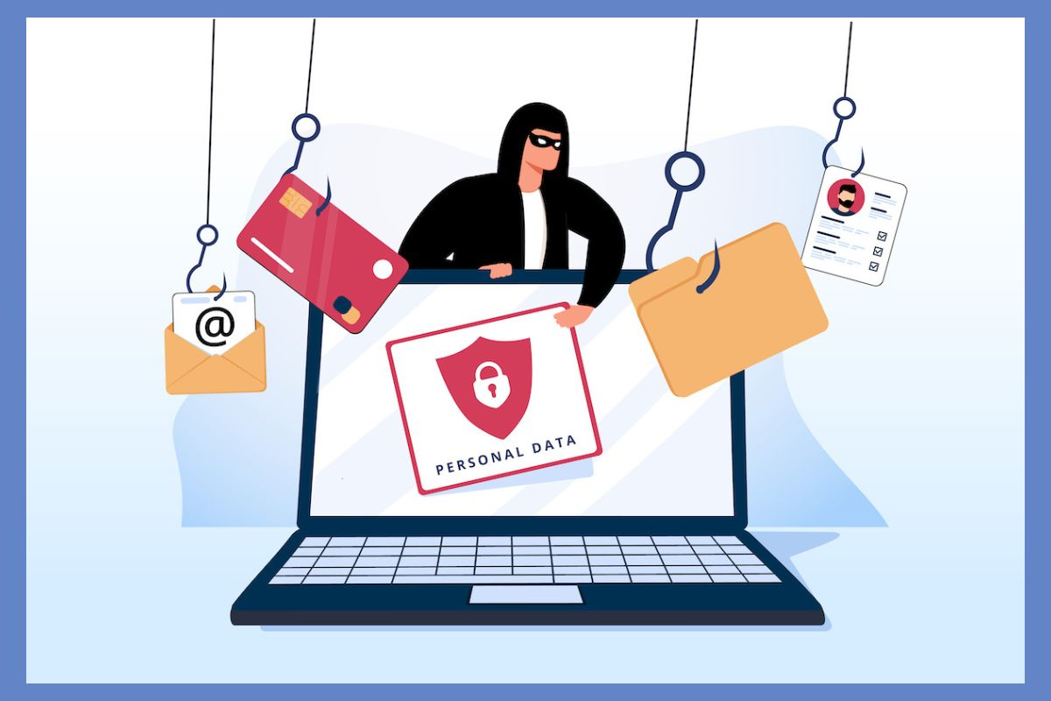
Phishing attacks use deceptive emails and fake websites to trick people into revealing sensitive information such as passwords or financial details. These emails often appear legitimate, using urgent messages or familiar branding to lure victims into clicking malicious links. The links typically lead to fake websites that closely mimic real ones, where users unknowingly enter their credentials or payment data. Common warning signs include suspicious sender addresses, slight URL misspellings, unexpected attachments, and requests for confidential information.
02
Phishing emails and fake websites

Slide 7
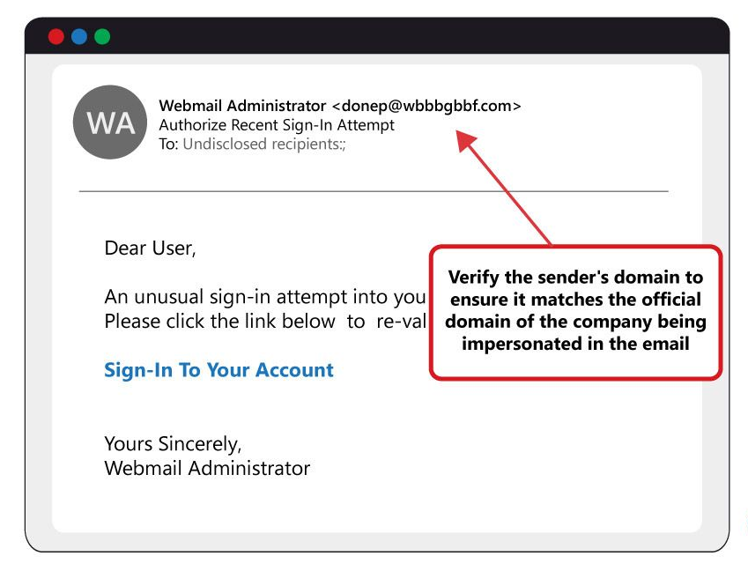
PHISHING EMAILS
Phishing emails are fraudulent messages that impersonate legitimate companies to trick you into giving up personal or financial information, such as passwords, credit card details, or login credentials. They often use urgent language, fake links, or malicious attachments to make you take action, and they can result in identity theft, financial loss, or malware installation.

Slide 8
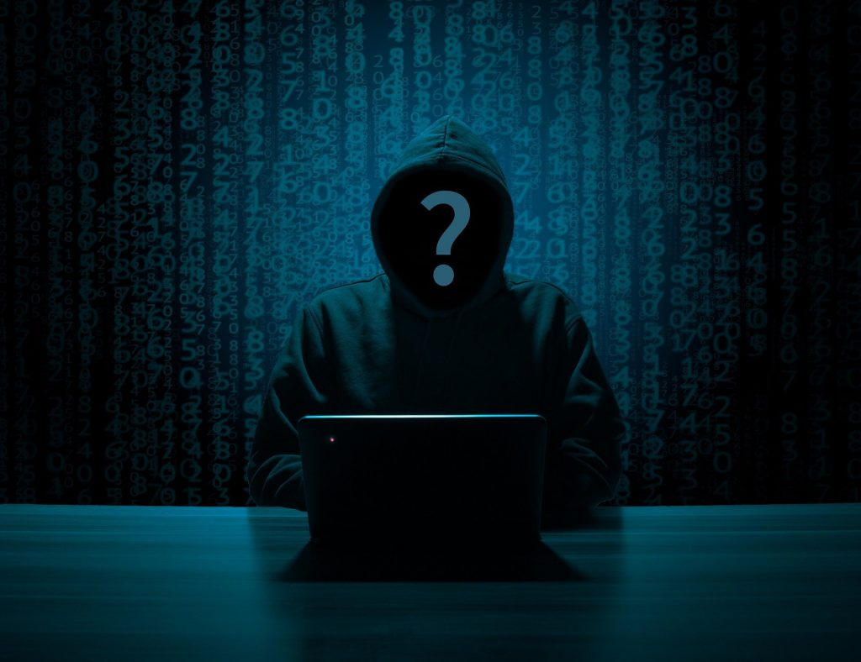
How to recognize phishing emails
Be cautious of the sender: Look for generic greetings, spelling and grammar mistakes, and check that the email address is from the legitimate domain (e.g., "@example.com," not "@example.co" or "@google.com").
Hover over links: Before clicking, hover your mouse cursor over any links to see the actual URL. If it looks different from what you expect, don't click.
Be skeptical of urgent requests: If an email claims there is a problem or a time-sensitive issue, pause and verify it directly with the company through a separate, official channel instead of clicking any links in the email.
Don't download attachments from unknown sources: Be wary of unexpected attachments, as they can contain malware.
Be suspicious of "too good to be true" offers: If an offer seems too good to be true, it probably is.
Report suspicious emails: Use your email provider's built-in tools to report phishing emails. This helps them improve their filters to protect you and others.

Slide 9
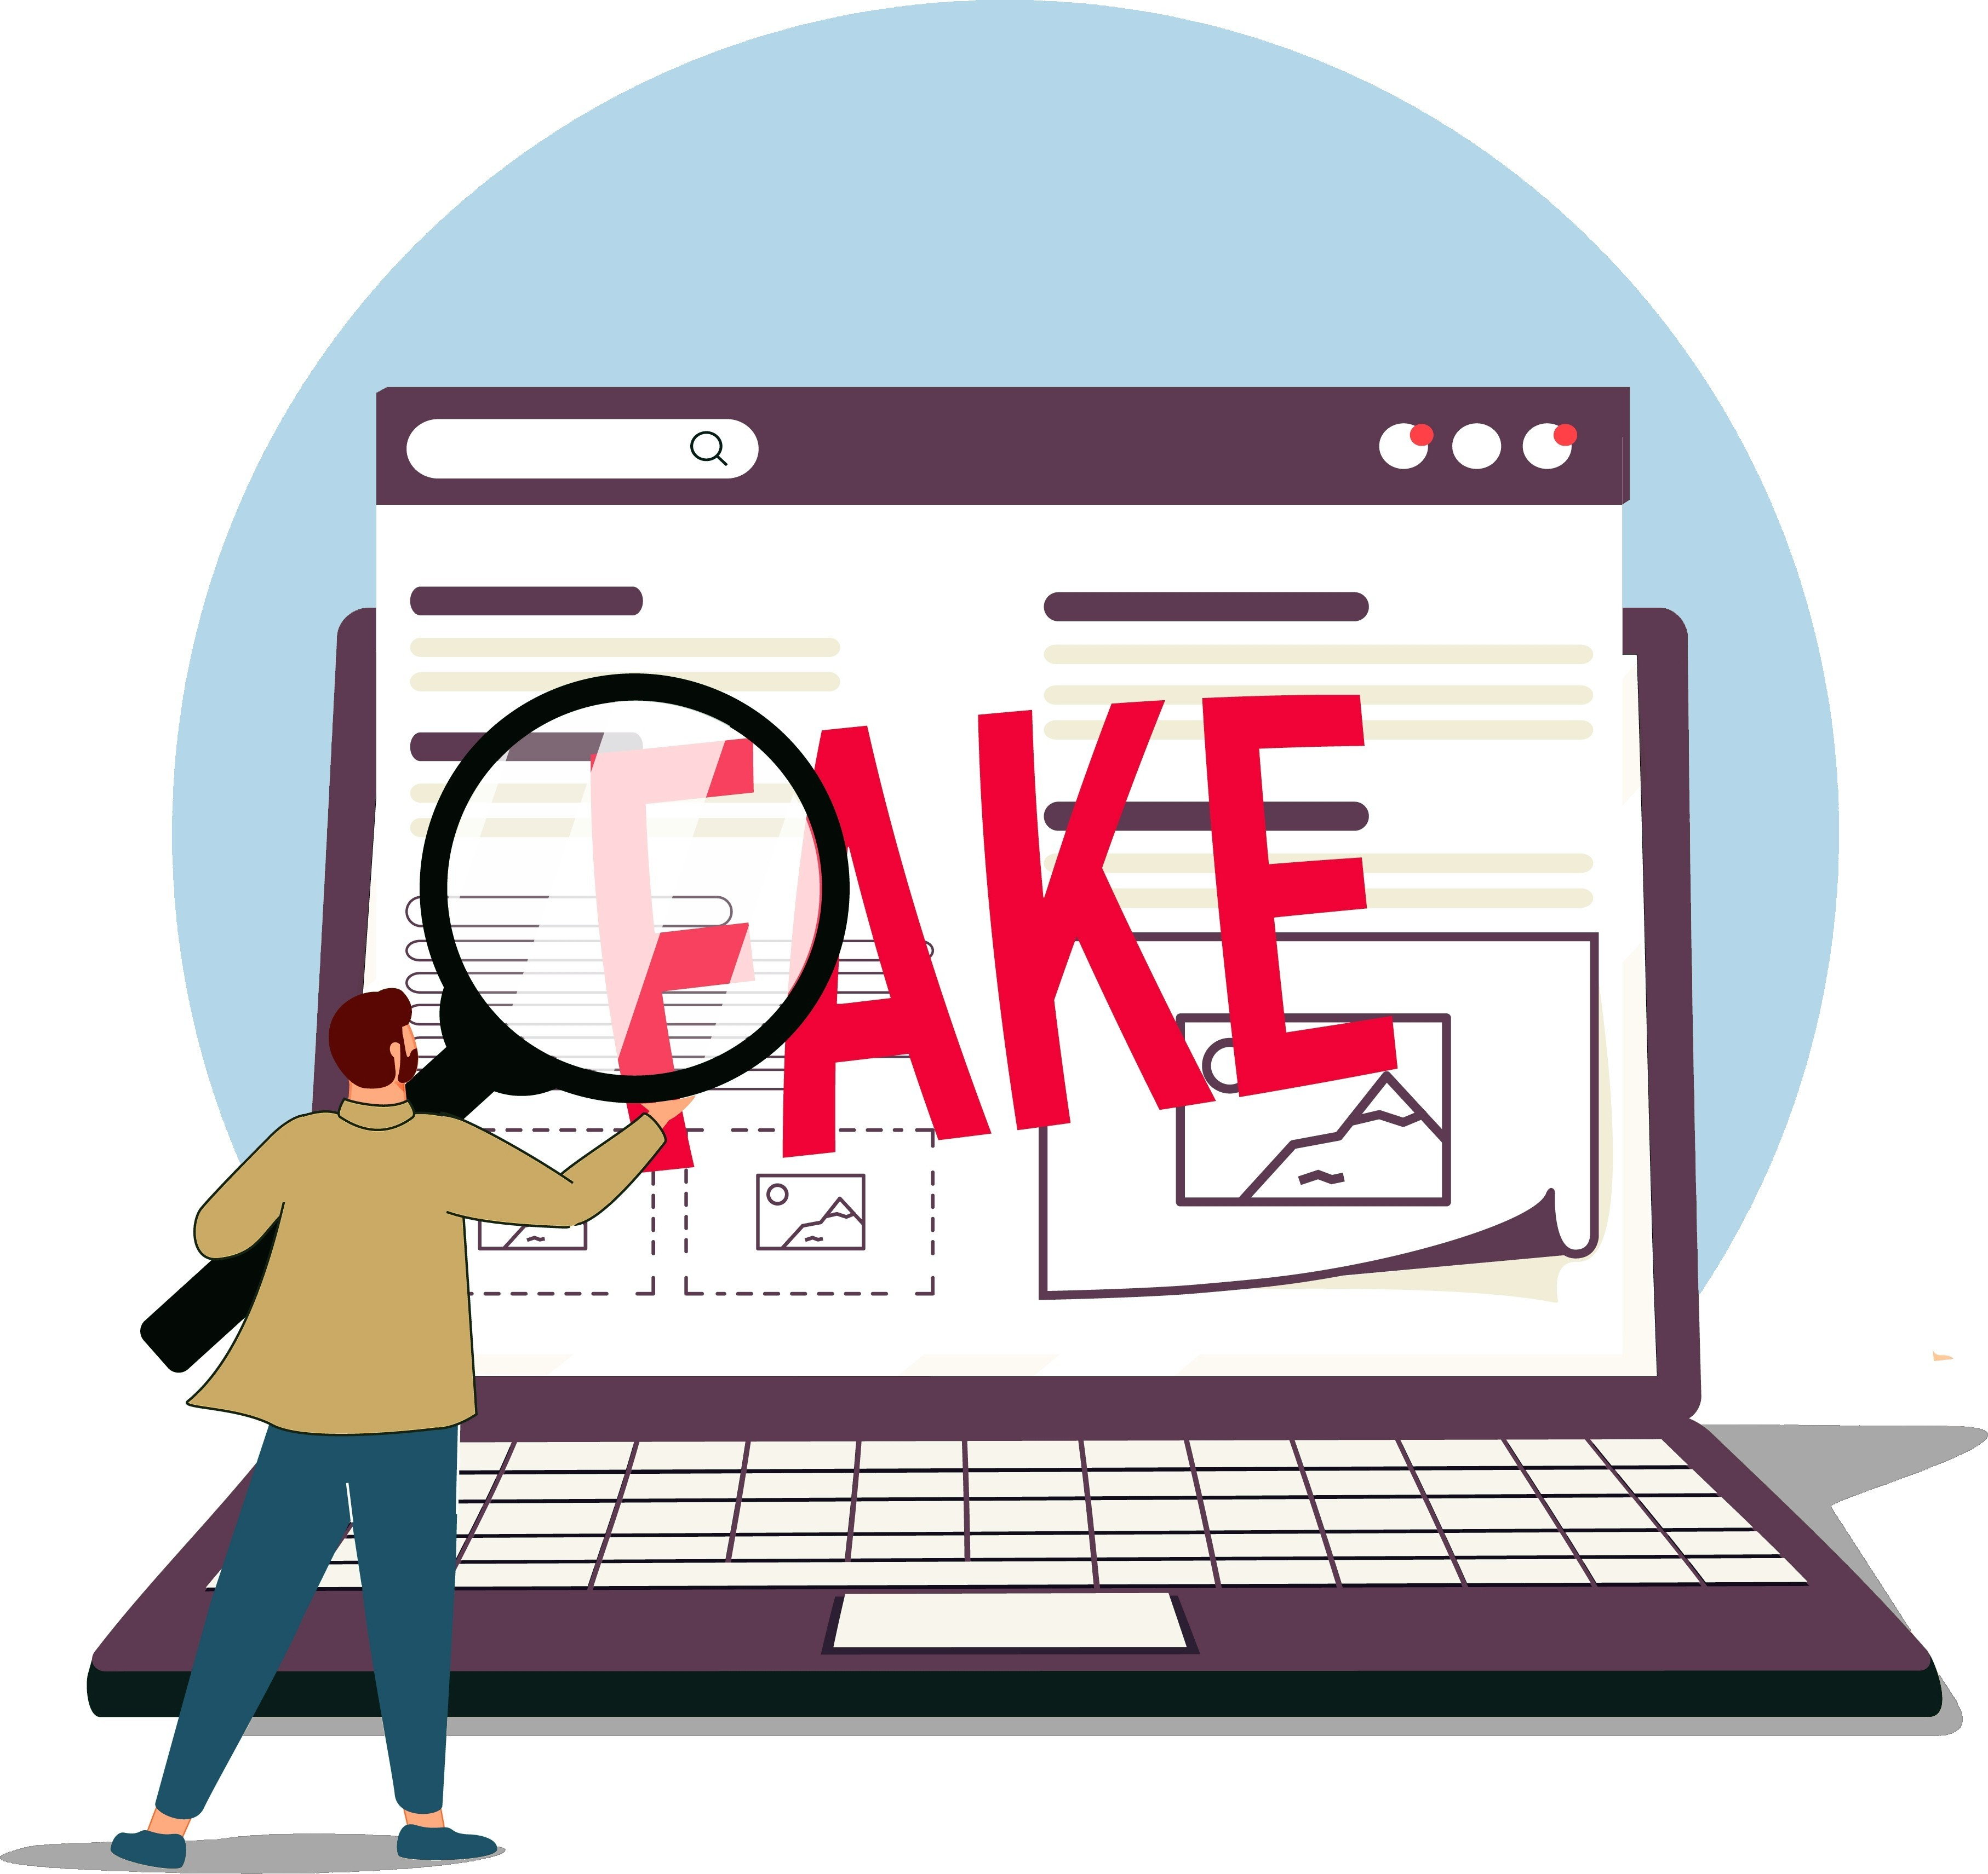
FAKE WEBSITES
Fake websites are malicious clones of real ones, built to mislead users into handing over credentials, personal data, or money. Most fake sites rely on website spoofing – the act of mimicking a legitimate brand site’s design, URL, and functionality - to gain users’ trust.
Once a user lands on a spoofed site, attackers can:
Steal credentials via phishing logins
Harvest credit card details
Install malware
Spread misinformation
They’re deployed at speed and scale, often using paid ads, SEO poisoning, social engineering, or SMS phishing to reach victims. Common targets include banking, e-commerce, streaming, airlines, and package delivery services.

Slide 10
TYPES OF FAKE WEBSITES
01
02
E-commerce scams
Account takeover setups
Attackers create fake online stores that closely mimic legitimate brands — often replicating logos, product listings, and promotional language. Victims may receive counterfeit goods, nothing at all, or unknowingly share payment data.
Spoofed login pages for services like banking, travel, and education are used to harvest credentials. Once obtained, these are used for account takeover or may be resold access on underground markets.
Common Types
03
04
Investment fraud
Gift card scams
Scam sites impersonate financial platforms, including brokerages and crypto apps, to trick users into transferring funds. They often promise high returns to accelerate decision-making.
Fake sites sell invalid, already-used, or counterfeit gift cards. Attackers may also use these sites to collect payment information for further fraud.

Slide 11
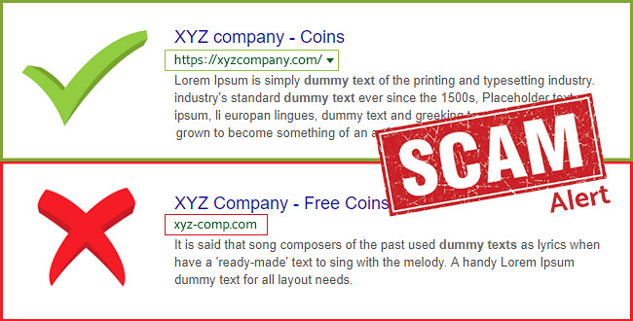
How Can You Spot a Fake Website?
Suspicious URLs (typos, extra words, misspelled brand names)
No HTTPS or invalid SSL certificates
Urgent language or popups pressuring action
Requests for sensitive info outside of known login flows
Linked from untrusted sources like random emails or texts

Slide 12
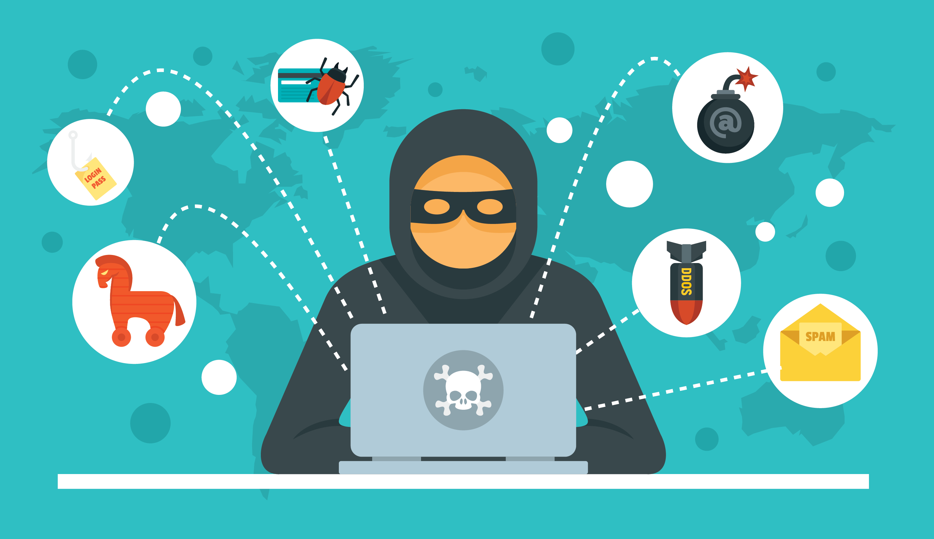
03
SOCIAL ENGINEERING
This is the art of impersonating as a trusted person, organization or group of people in order to obtain information which is valuable. Over the past years there has been a rise in cases which involve social engineering attacks. Social engineering attacks can be divided into several categories ranking them from simple to complex forms.

Slide 13
How it works?
Information gathering
Establishing a relationship
Delivery
Exploitation
Execution
01
02
03
04
05
Reconnaissance
Crafting the Bait
Method
Data extraction
Ending the interaction
Attackers gather information about the target through public sources or social media.
They design convincing messages that trigger emotions like fear, urgency, or curiosity.
The message is sent through email, SMS, or phone.
The victim interacts with the malicious element (link or file), leading to credential theft or malware installation.
Once the attacker has achieved their objective, they terminate the interaction and cover their tracks to avoid being caught.

Slide 14
SOCIAL ENGINEERING ATTACKS
01
02
Spear Phishing
Vishing
Highly targeted phishing aimed at specific individuals or organizations using personal details.
Voice phishing over phone calls, often impersonating bank or tech support staff.
03
04
Pretexting
Quid Pro Quo
Attackers create a believable story or identity (e.g., pretending to be HR or IT) to extract information.
Offering a service or benefit in exchange for sensitive information, such as fake tech support assistance.

Slide 15

04
Avoidance and mitigation

Slide 16
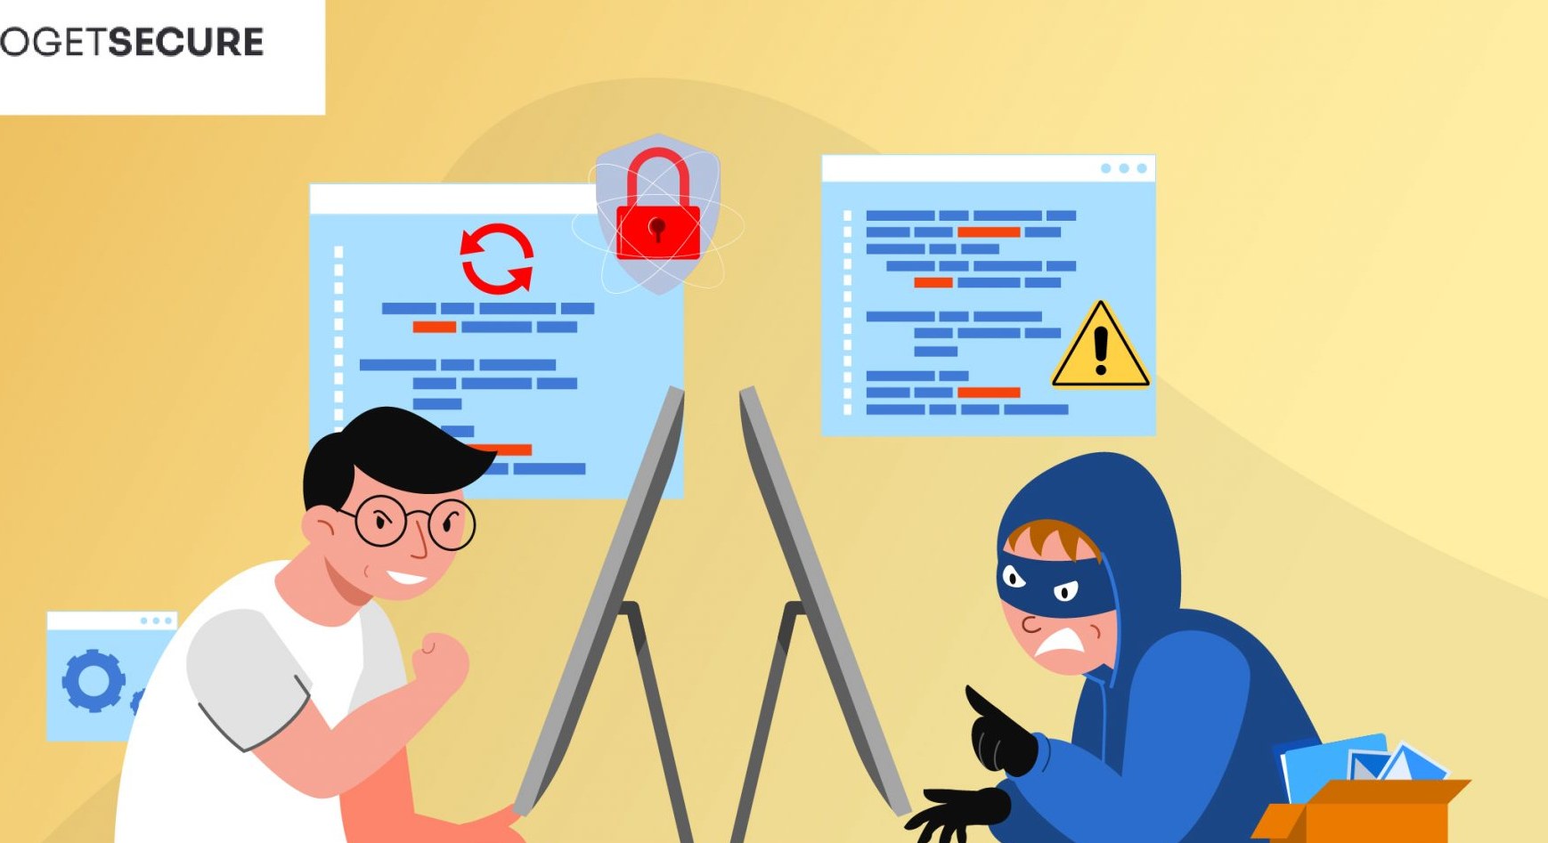
TECHNICAL MEASURES
02
03
Authentication
Endpoint and network security
Enable multi-factor authentication (MFA) for all accounts.
Keep systems patched and use updated antivirus solutions.
01
04
Emai and web security
Filtering
Implement email filters, SPF, DKIM, and DMARC protocols.
Use web filtering to block malicious sites.

Slide 17
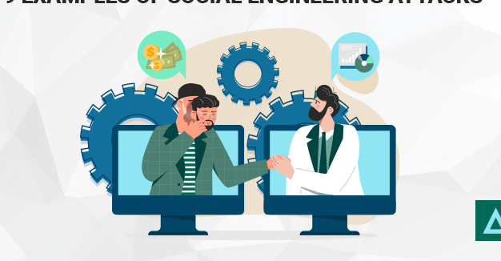
HUMAN AND ORGANIZATIONAL MEASURES
02
03
Simulation
Reporting
Simulate phishing attacks to assess employee readiness.
Establish clear reporting procedures for suspicious emails.
01
04
Awareness
Auditing
Conduct regular security awareness training.
Enforce least-privilege access policies.

Slide 18
REAL-WORLD INCIDENTS
Netflix Subscription Alerts
In a 2023 campaign, fake Netflix sites mimicked the brand’s login interface and told users their accounts would be suspended due to billing errors. Victims submitted their details, which were used for both account take overs and credit card fraud. Users lost $2,270 on average. The company had to reset the passwords of all affected users, send out warnings, and strengthen its security measures to allow earlier and easier fraud detection.
Twitter Bitcoin Scam
On July 15, 2020, several high-profile Twitter accounts — including those of Elon Musk, Barack Obama, and Apple — were hijacked. Attackers gained internal access by phishing Twitter employees for administrative credentials. The compromised accounts were used to post cryptocurrency scam messages, leading followers to send Bitcoin to fraudulent wallets.
Change Healthcare Breach
In early 2024, U.S. healthcare giant Change Healthcare suffered a major breach initiated by a phishing attack. Hackers stole employee credentials and used them to access internal systems, disrupting healthcare payment processing nationwide. The incident impacted millions of users and emphasized how credential-based phishing remains a primary entry point for large-scale breaches.

Slide 19
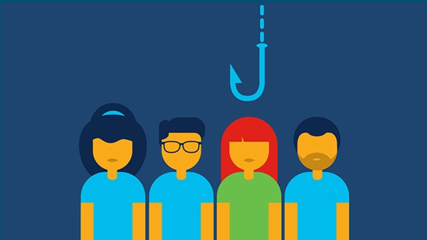
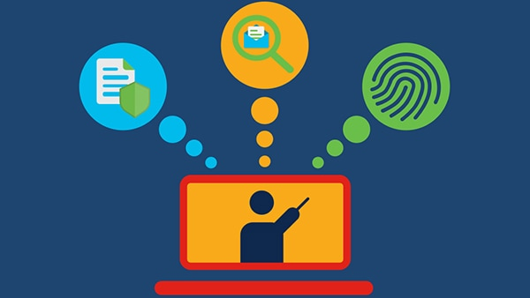
Quiz
01
02
What should you do as an employee if you suspect a phishing attack?
Report it so the organization can investigate.
Ignore it.
Open the email and see whether it looks legitimate.
Show your coworkers to see what they think.
What are the most common signs of a phishing scams?
Nice graphics and layout
Contains personal information
Proper spelling and grammar
Unknown sender, sense of urgency, unexpected attachment, or too good to be true

Slide 20
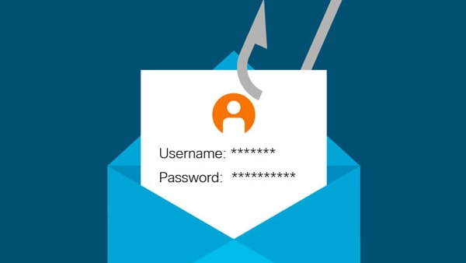
Quiz
03
04
What can happen if you click on a phishing email link or attachment?
The email sender could gain access to company systems.
The email sender could steal your personal information or company information.
The email sender could distribute malware into the company network.
All of the above
A phishing attack that incorporates personal information about the user is known as which of the following?
Website spoofing
Spear phishing
DNS copying
Spam filtering

Slide 21
CONCLUSION
Phishing remains one of the most common and dangerous cyber threats because it targets human behavior rather than technology. Even with advanced security systems, a single careless click can lead to major data breaches or financial losses. Understanding how phishing works, recognizing warning signs, and practicing safe online behavior are essential defenses.
Continuous awareness training, strong authentication methods, and cautious email habits together form the best protection against phishing attacks.
By staying vigilant, verifying communications, and following best practices, individuals and organizations can significantly reduce the risk and impact of phishing attacks.

Slide 22
ALWAYS BE PREPARED
THANK YOU

